Slide 1
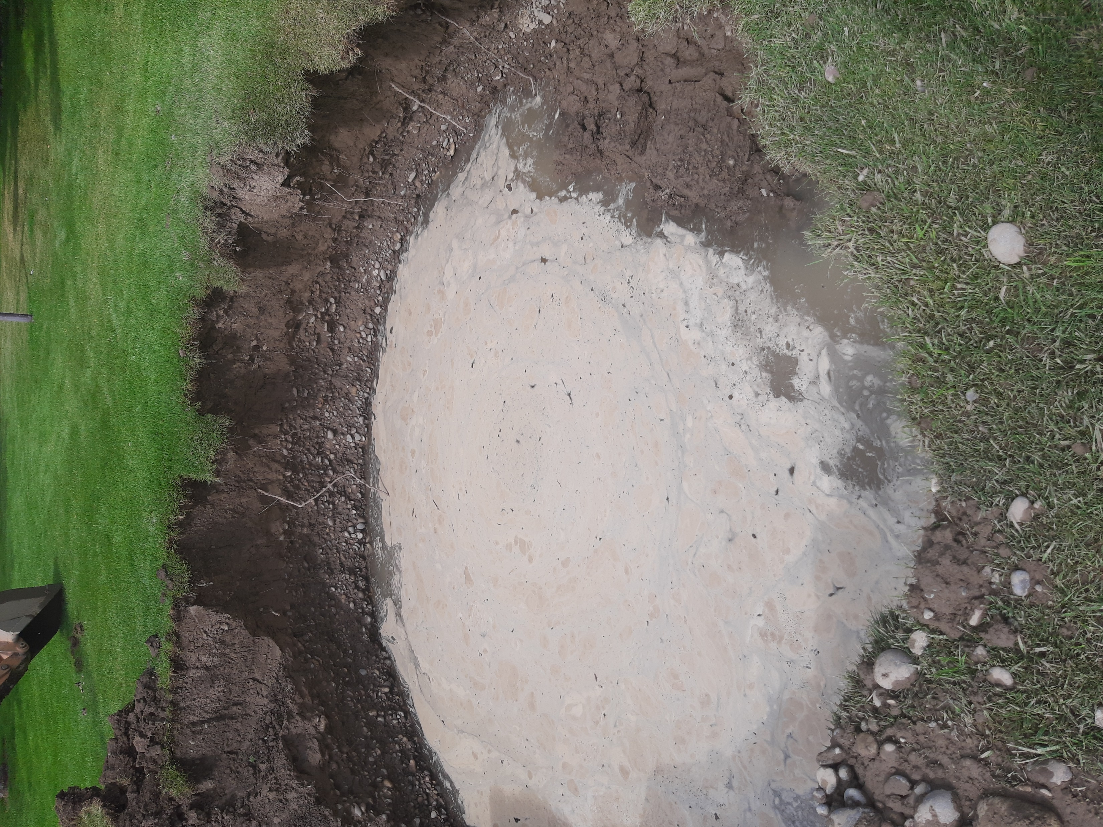
2026 Installer refresher class
Ground Water Monitoring
Extra Drainrock Trench
Intrenched Sand Filter

Slide 2
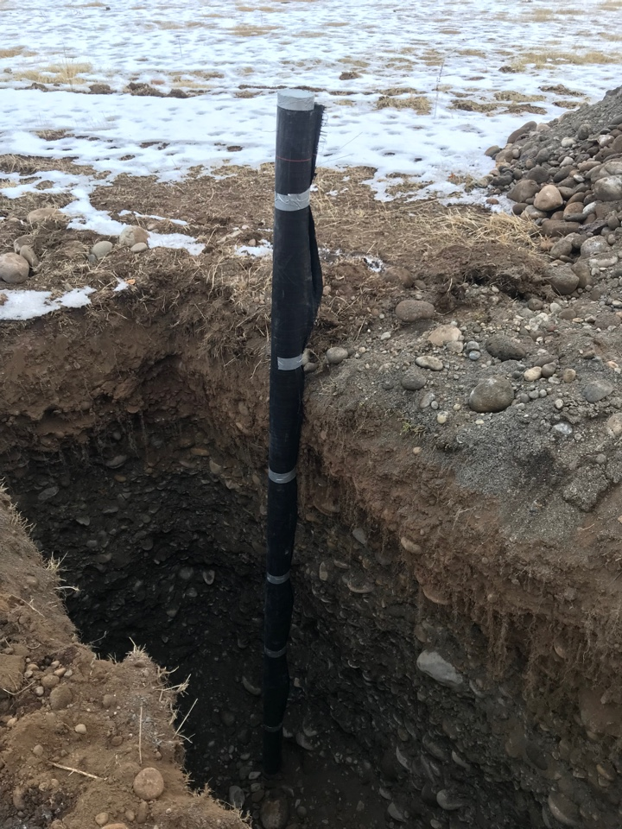
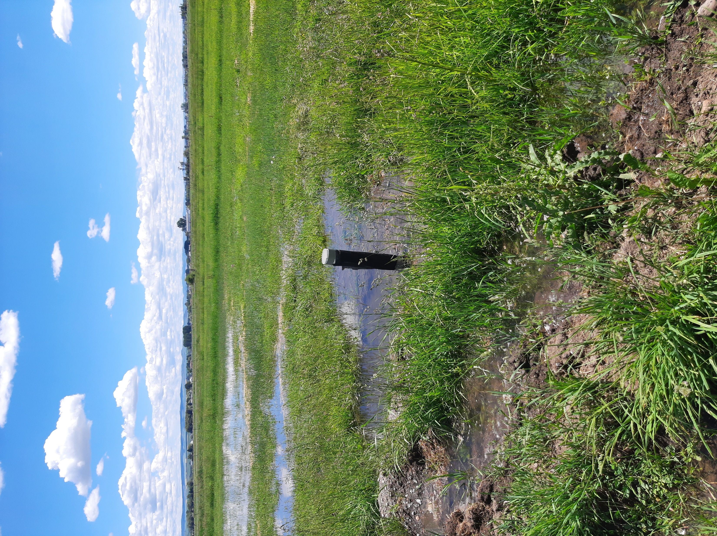
Groundwater Monitoring
IDAPA 58.01.03 – Individual/Subsurface Sewage and Cleaning of Septic Tanks: Section 003 15.
High Groundwater Level –
Normal Vs. Seasonal.
a. The normal high groundwater level is the highest elevation of ground water that is maintained or exceeded for a continuous period of six (6) weeks a year.
b. The seasonal high groundwater level is the highest elevation of ground water that is maintained or exceeded for a continuous period of one (1) week a year.

Slide 3
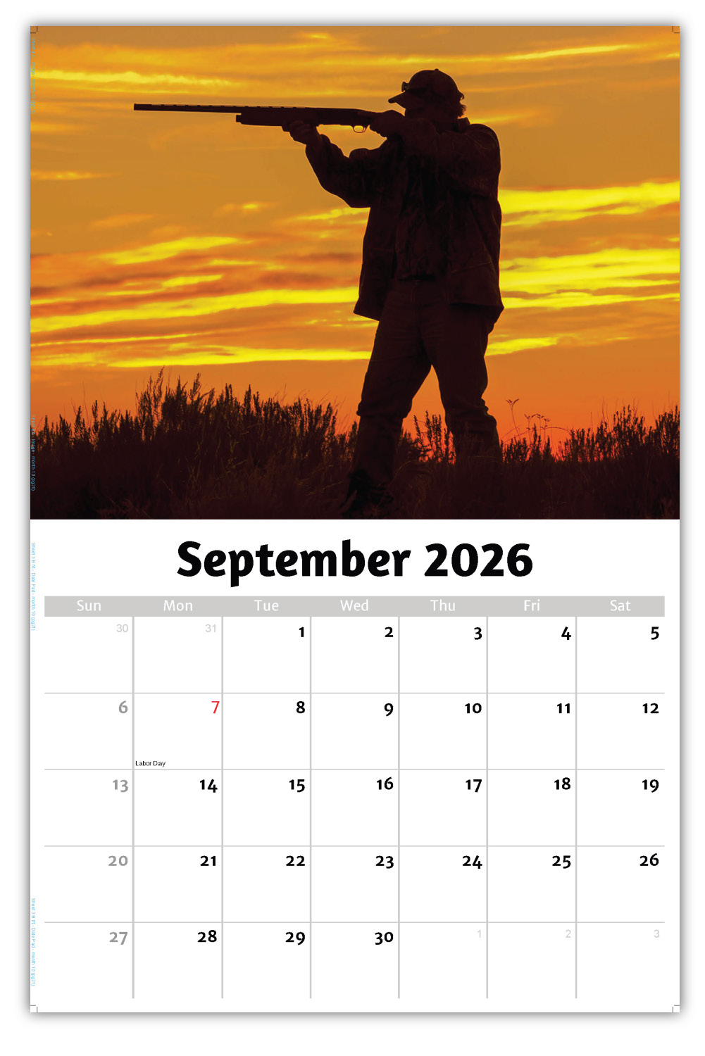

When to Monitor?
Ground water monitoring is to be conducted during the time of peak ground water levels. For areas where spring runoff is the primary source of ground water, monitoring should be conducted February through June. For sites where irrigation is expected to be the primary source of ground water, monitoring should take place April through October. The applicant or representative will monitor the ground water levels on a weekly basis to collect the ground water elevation data. An EHS may perform quality control checks by monitoring the ground water levels as their schedule allows. A site by site determination on who will monitor ground water levels will be made based on Health District manpower availability.

Slide 5
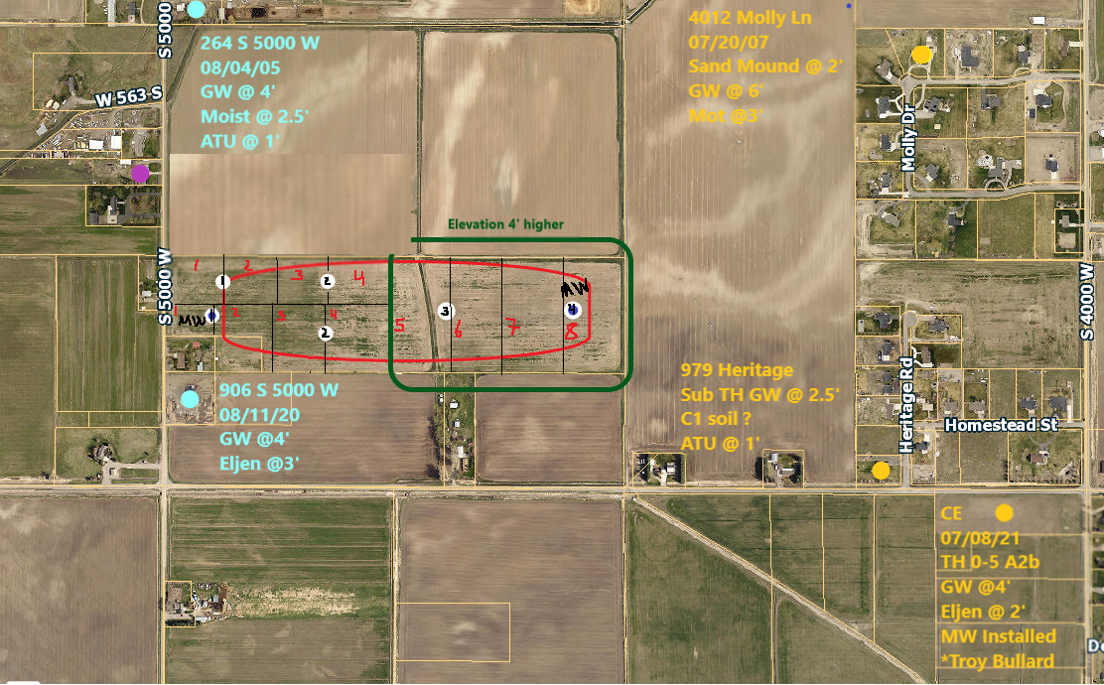
Based on elevation? Ehhhhh….

Slide 6
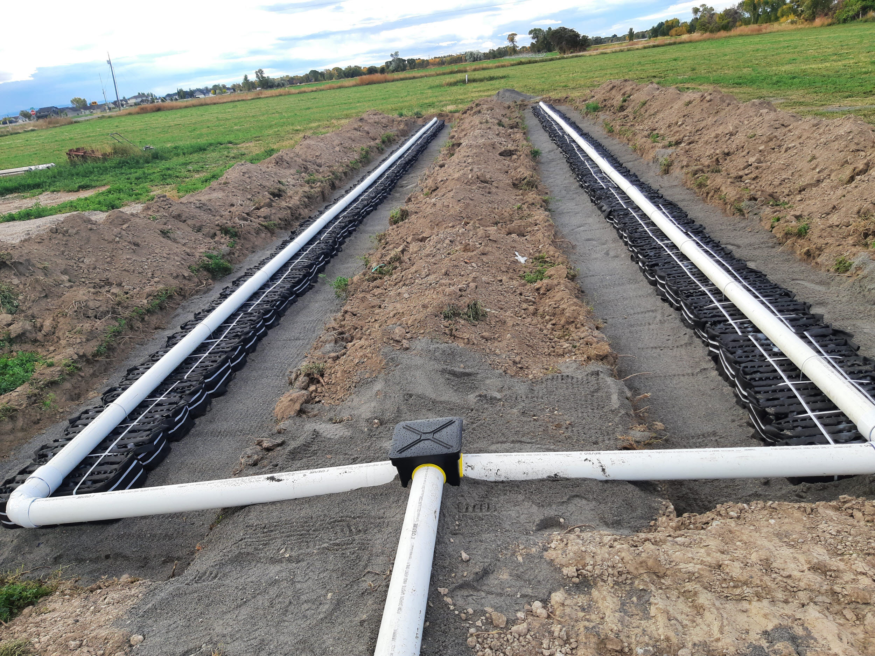
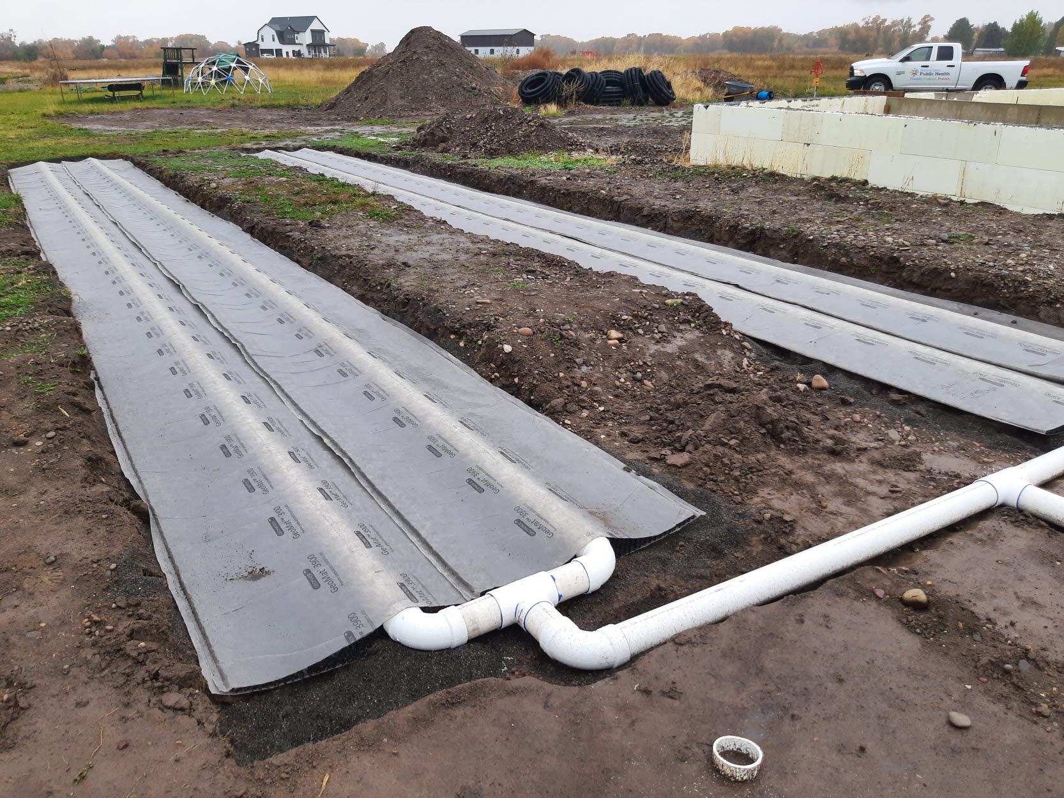
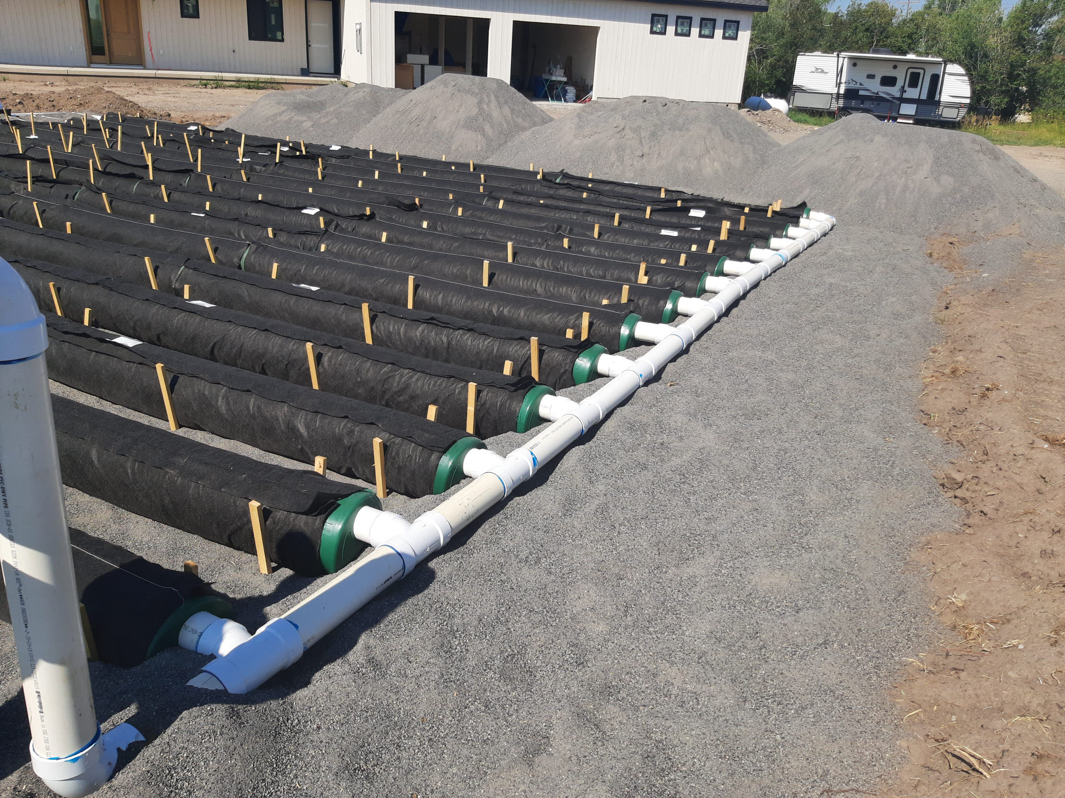
Solutions
**Allowed to install one foot above seasonal high levels
Complex/proprietary system type options:
Aerofin -Infiltrator
ATL -Infiltrator
Eljen
ETPS
GeoMat
Lowridge Oscar II
Presby -Infiltrator
Sand Mound (needs engineering)

Slide 7
I need it now!
If historical records allow, issue conservative complex shallow permit now.
Complete monitoring season. Submit collected data records.
If recorded data allows for change to original permit than apply for permit amendment based on collected data.
        $450 permit amendment fee

Slide 8
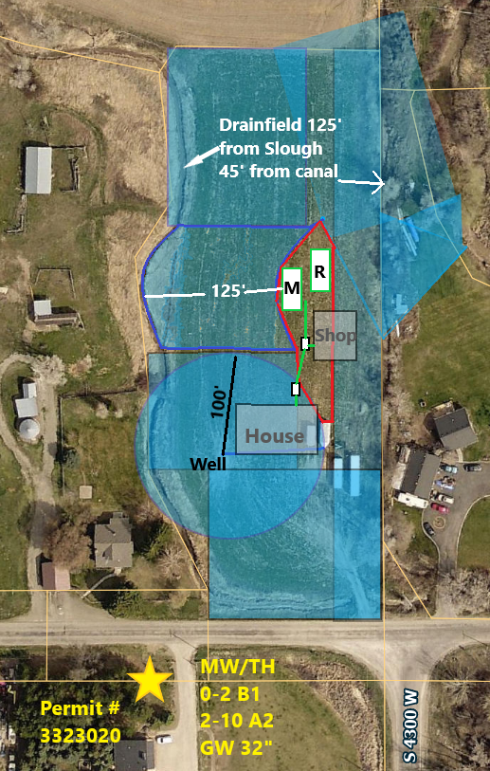
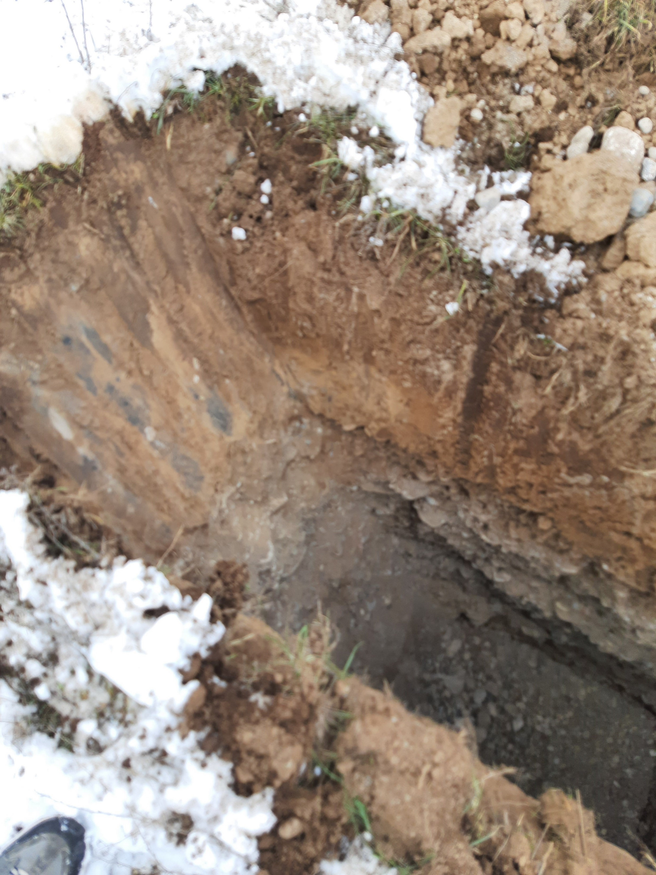
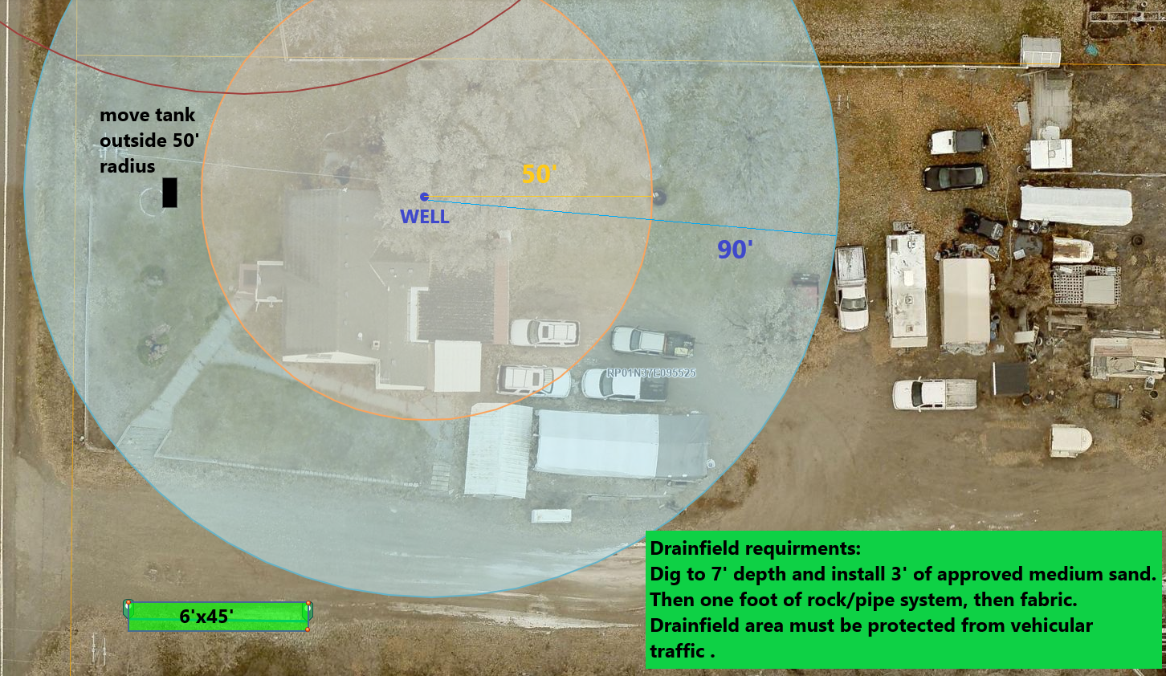
Other site-specific problems and solutions
SPACE!! Small lot/Neighboring well setbacks/Surface water
Poor soil conditions

Slide 9
TGM 4.23
In-Trench Sand Filter
Revision: May 13, 2021
Installer registration permit: Property owner or standard and basic (complex if pretreated and pressurized enveloped)
Licensed professional engineer required: No (yes if pressurized enveloped)
4.23.1 Description
An in-trench sand filter is a standard trench or bed system receiving effluent by either gravity or low-pressure flow, under which is placed a filter of manufactured medium sand meeting the definitions provided in section 3.2.8.1.2.
*** Medium sand must be from approved provider/pit. Check the list!!!

Slide 10
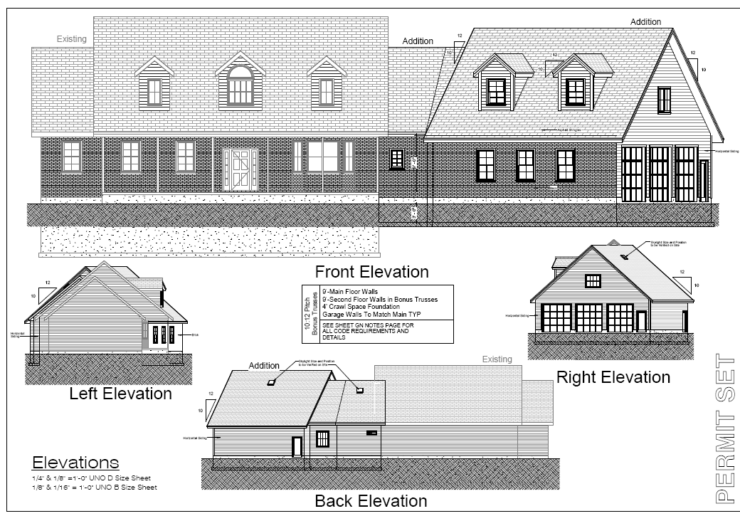
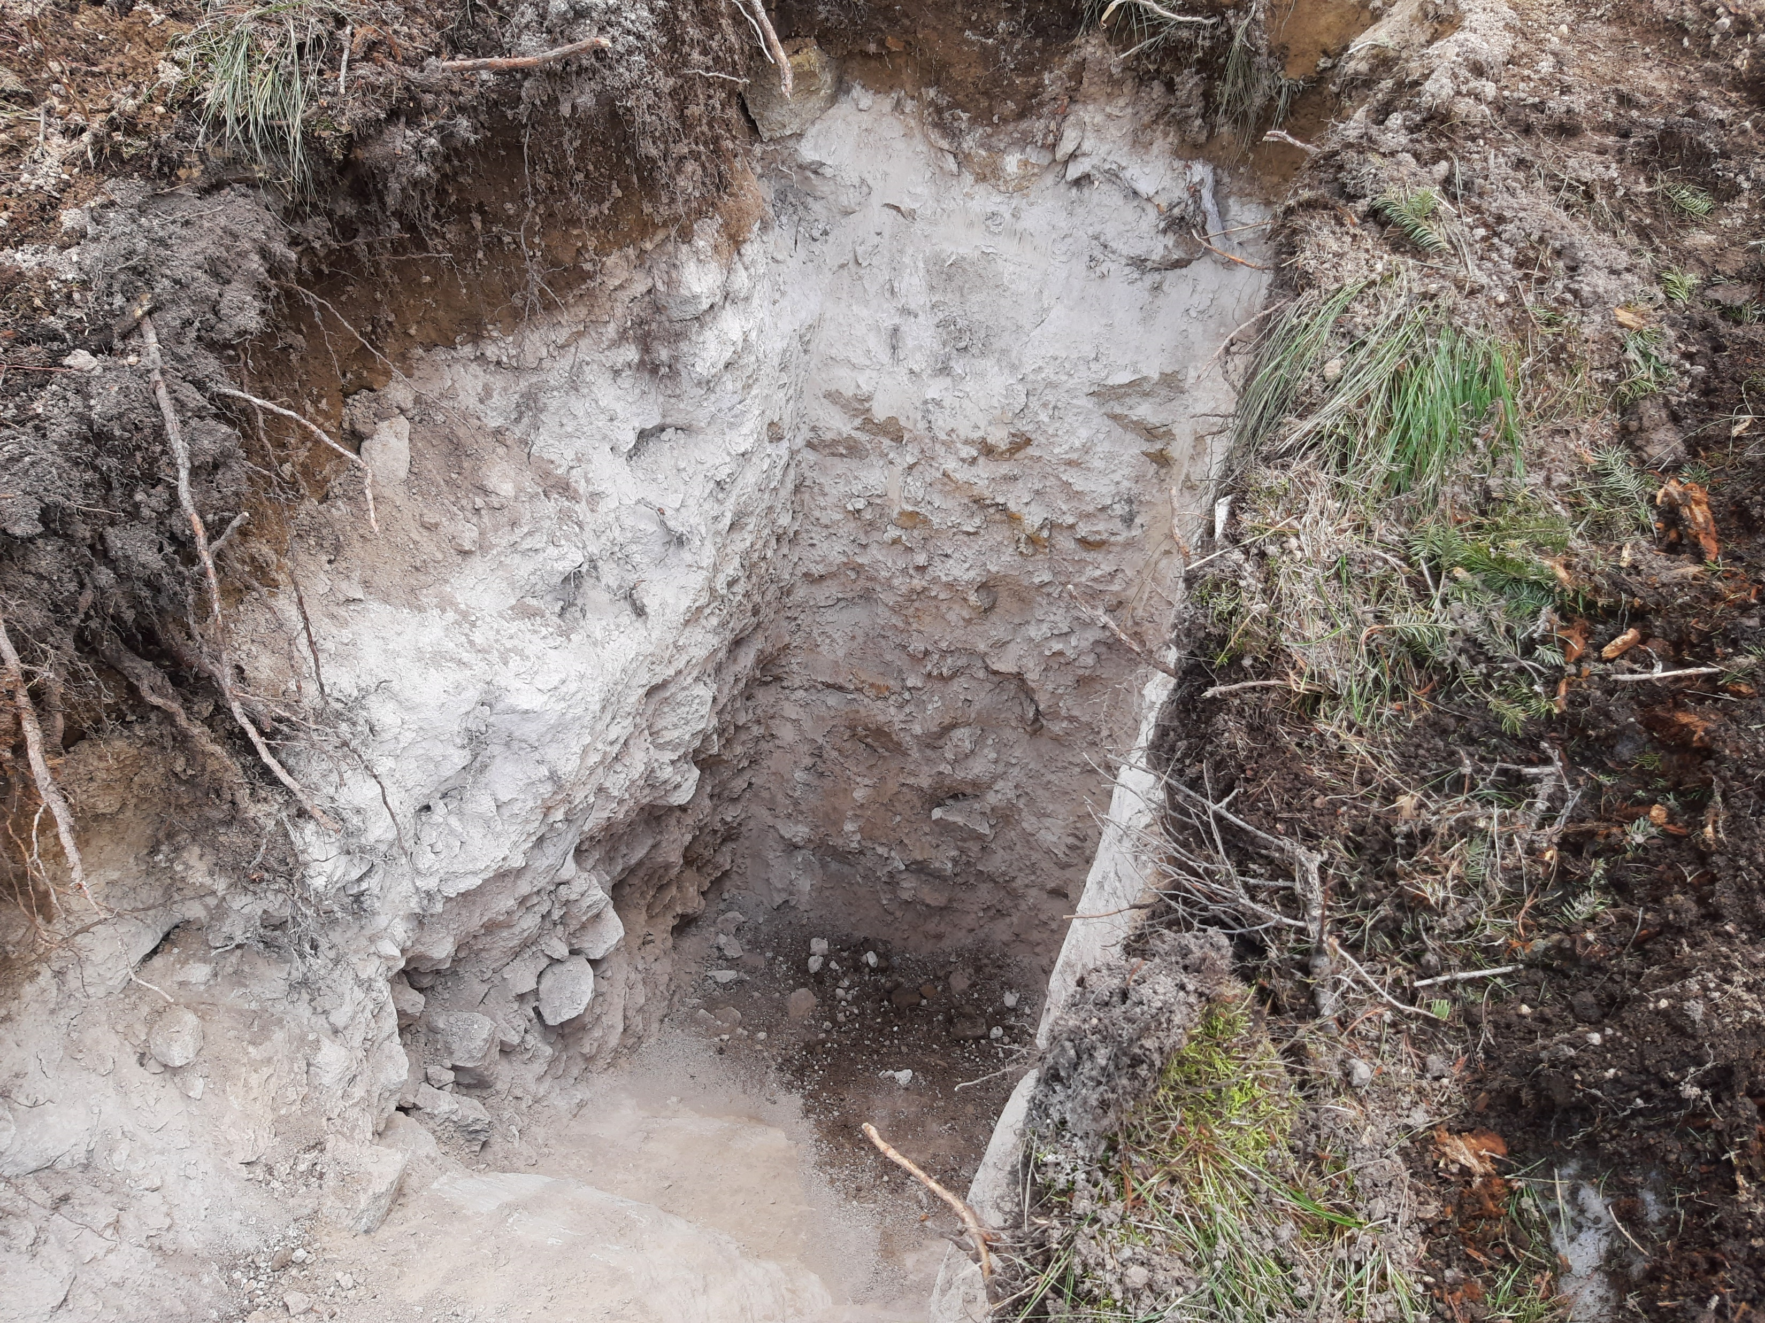
Primary usage is to help fit septic footprint
Onsite Test Hole soils profile:
0-5.5 C1 silty clay
5.5-10 A1 sand
with >60% rock
Septic Application:
5 bed residential home
350 gpd
C1 soil is 0.3 application rate
= 1167 sq ft drainfield area

Slide 11
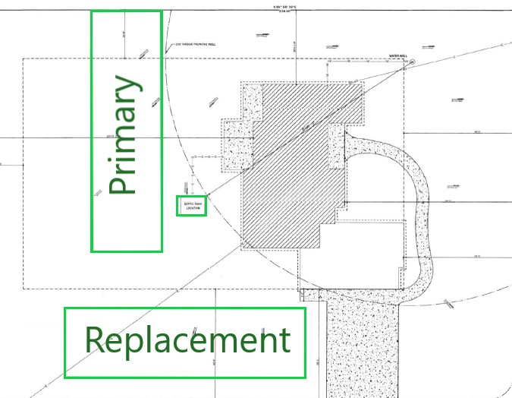
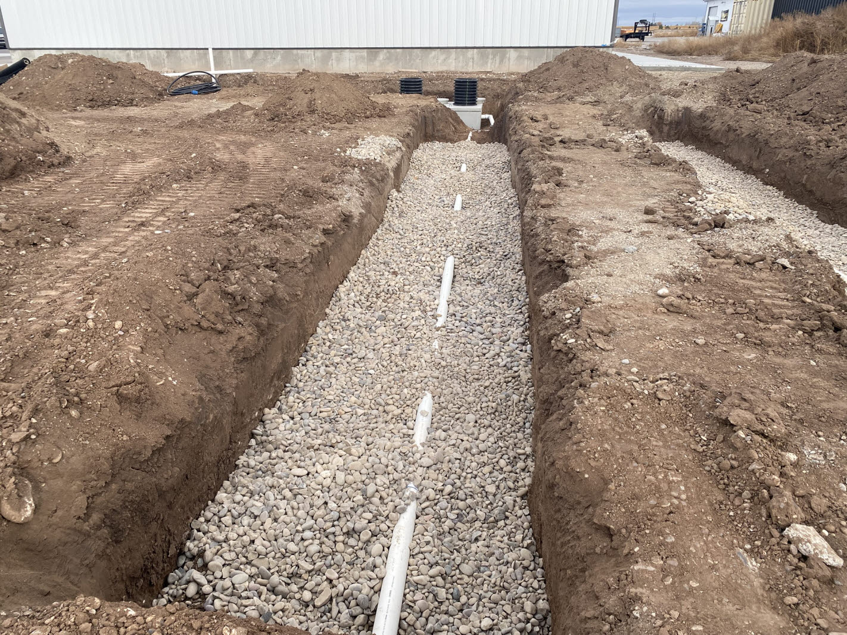
Trench Design-
Using 6-foot-wide trench with Rock and Pipe
Two- 6’ X 98’ Trench
**Overall footprint per system 18’ X 98’ = 1764 sq ft
5 bed residential home
350 gpd
C1 soil is 0.3 application rate
= 1167 sq ft drainfield area

Slide 12
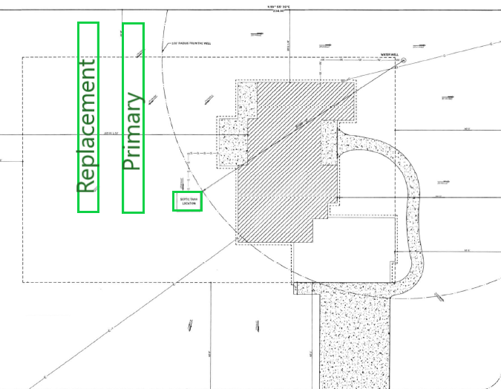
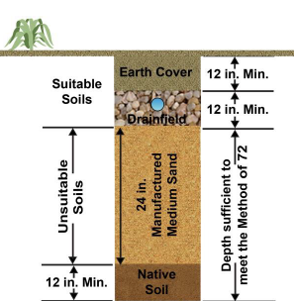
Basic
Intrench Sand Filter (ISF)
Permit conditions of approval-
Excavate to 6-foot depth or as needed to reach sand layer then backfill to at least 4-foot depth and install system
Using 6-foot-wide trench with Rock and Pipe
ONE- 6’ X 78’ Trench (700 sq ft less)
with 2 feet of sand ~35 yards sand
Overall footprint for both systems is 1404 sq ft
5 bed residential home
350 gpd
A1 soil with >60% rock
is 0.75 application rate
= 467 sq ft drainfield area

Slide 13
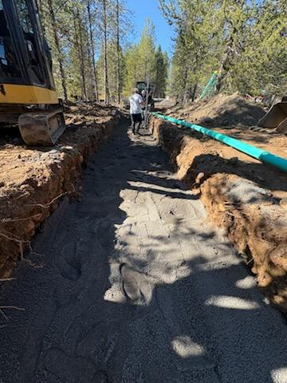
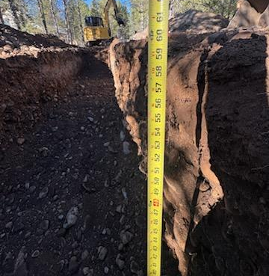
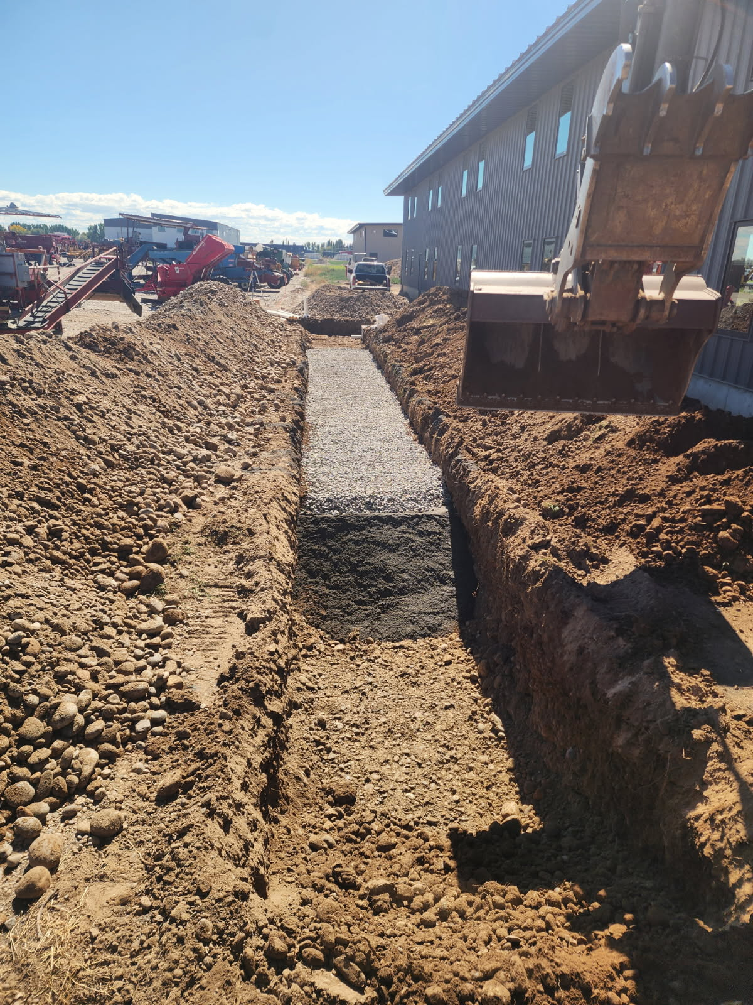
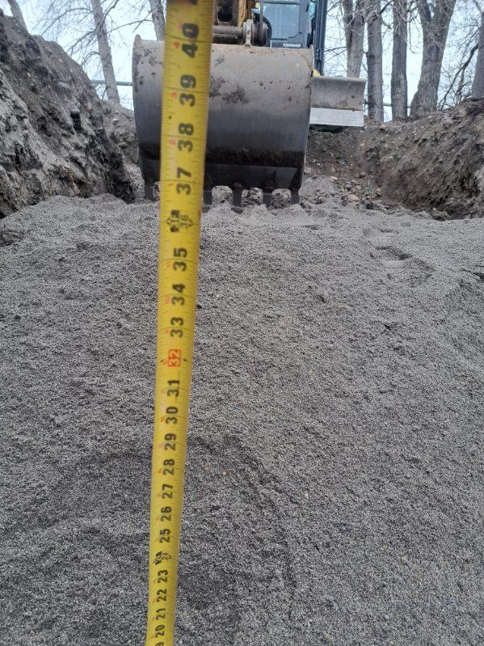
Inspection- document excavation and install of sand

Slide 14
TGM 4.9
Extra Drainrock Trench
Revision: December 10, 2014
Installer registration permit: Property owner or standard and basic
Licensed professional engineer required: No
4.9.1 Description
An extra drainrock trench is an aggregate-filled trench (1 to 6 feet wide) with more than 6 inches of aggregate under the perforated pipe. When more than 6 inches of aggregate is installed under the perforated pipe in a drainfield, the required drainfield length may be reduced.
*** Drainrock must be from approved provider/pit. Check the list!!!

Slide 15

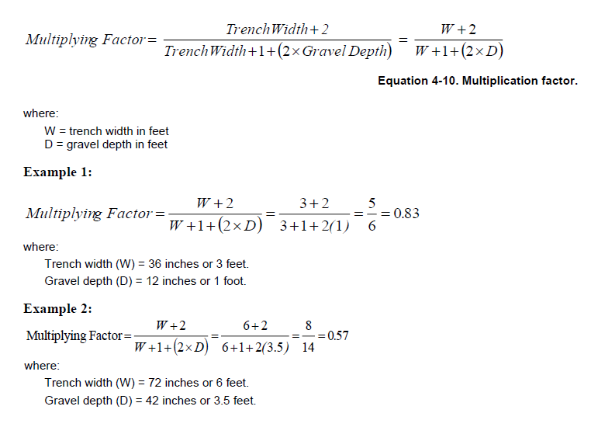
For the Engineers: TGM Equation 4-10

Slide 16

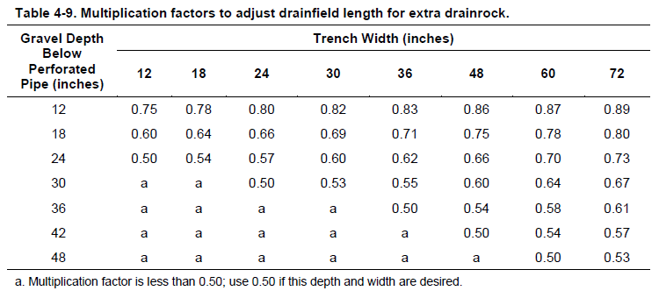
The rest of us…

Slide 17
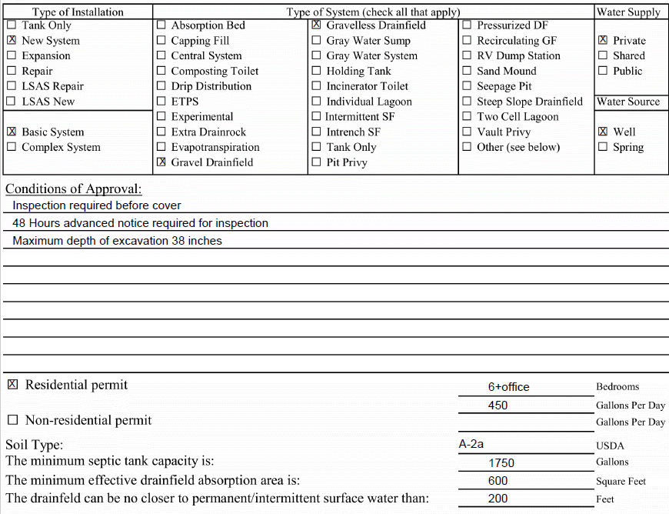
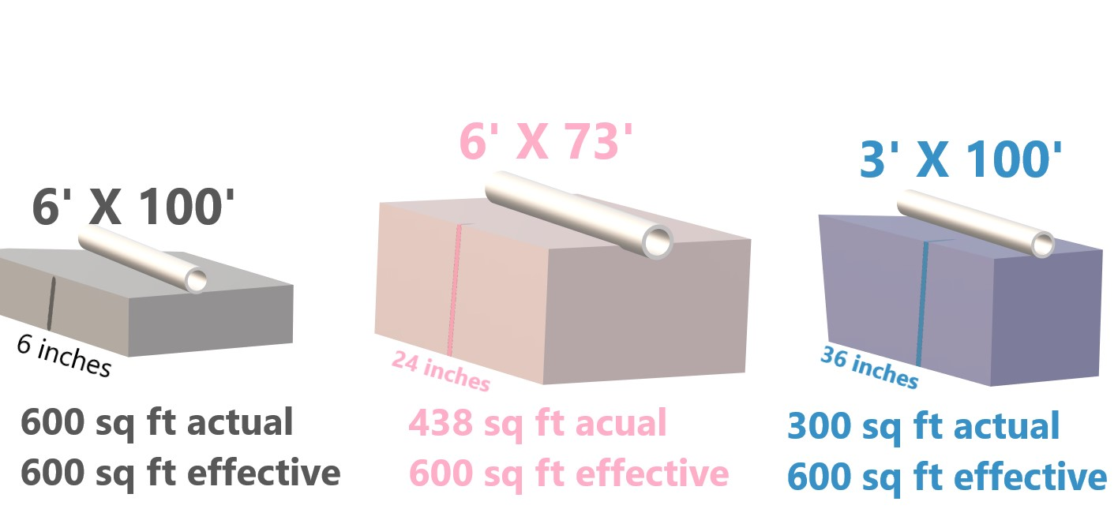
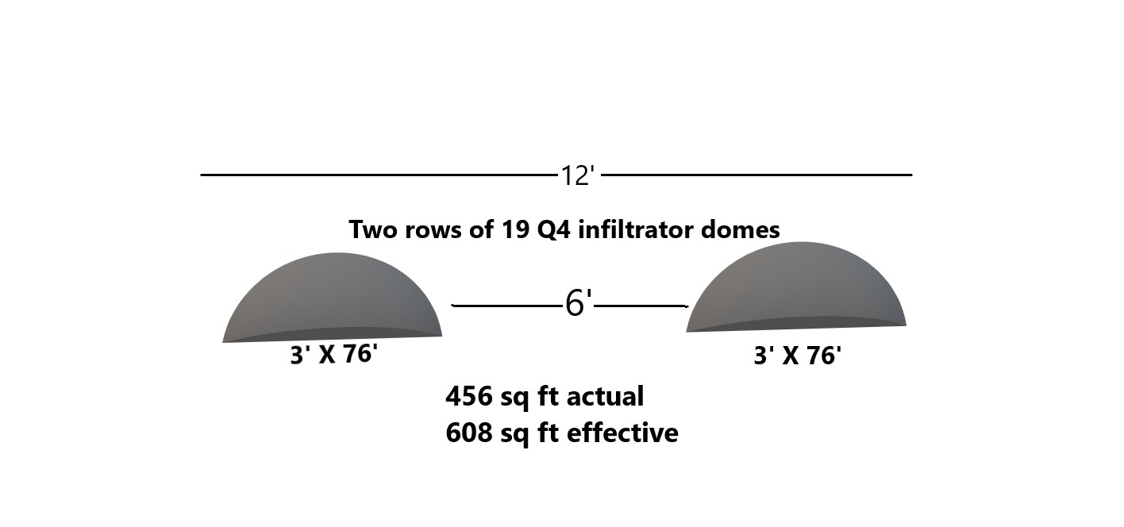
Permit issued as
Basic
600 sq ft gravel or gravelless
Gravelless component multiplication factor is always 0.75

Slide 18
Example: Onsite Eval and Permit for 400 GPD
400 gpd with a C2 application rate of 0.2 has a drainfield size requirements of 2000 sq ft
C1
Using gravelless domes still needs 1750 sq ft
> 1500 sq ft required to be pressurized
OR…
Permitted as an Intrenched sand filter with extra drainrock:
C2
400 gpd is reduced to A2b application rate using the ISF and gives a drainfield size requirement of 533 sq ft
Then
Using 48 inch of extra drainrock in a 6-foot-wide trench gives a reduction of 0.53 = 283 sq ft
A2b

Slide 19

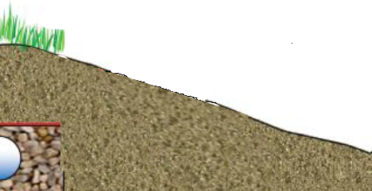

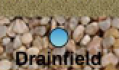
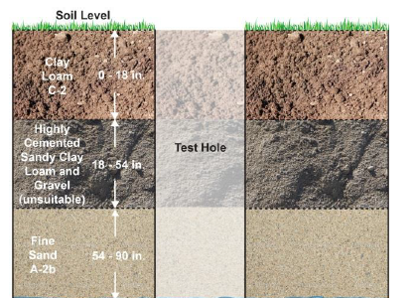
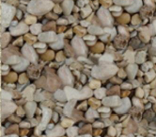

Installed:
Excavated to 6 foot
One foot med sand then 4 feet drainrock
One trench 6’ X 48’
Actual sq ft = 288 sq ft
Effective sq ft = 543 sq ft
**Above Grade
Capping Fill
18”
C1
**48 extra drainrock
C2
4’
12”
**One foot med sand
Used as Intrenched Sand Filter
A2b

Slide 20
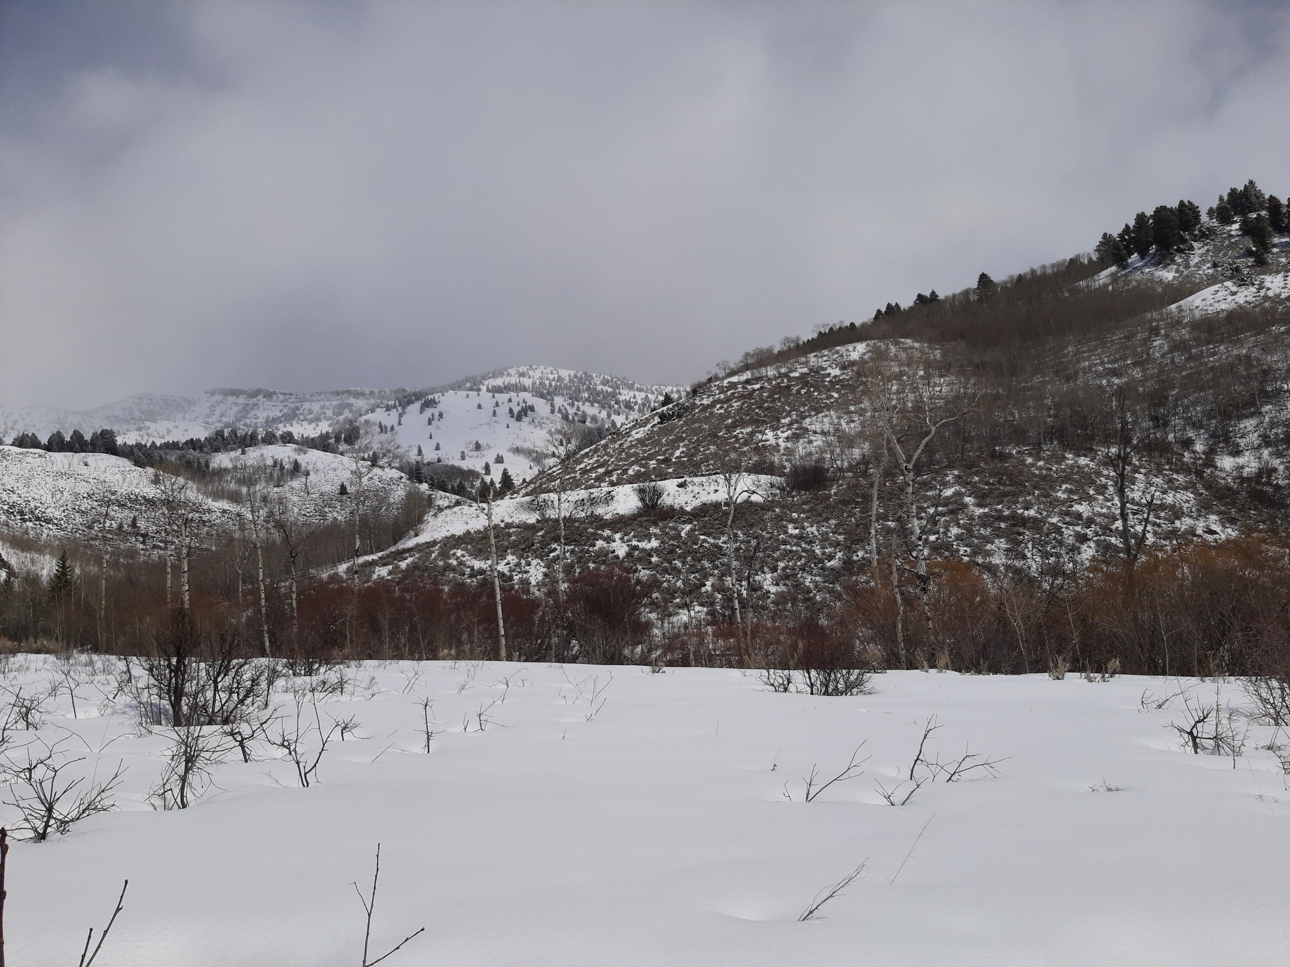
Questions???????????

