Slide 1
Idaho Subsurface Program Updates
Calendar Year 2025
James Craft
Wastewater Compliance Bureau Chief

Slide 2
Jayson Foley –
Senior Onsite Wastewater Analyst
jayson.foley@deq.idaho.gov
(208) 373-0341

Slide 3
Agenda Slide
Online Installer Exam
IDAPA 58.01.03 Rule Updates
TGC meetings info
2025 Updates to TGM
DEQ memorandums
Tank Mods in the field, a No-No
By the Numbers: Idaho Septic Permits in 2025

Slide 4
Online Installer Exam

Slide 5
Online Installer Exam
Visit deq.idaho.gov
“Septic Installer Exam”:
• Schedule & take an in-person exam at your local health district or take it online via the National Onsite Wastewater Recycling Association (NOWRA).
• For the online option:
1) Download and read the Online Exam Instructions.
2) Download and read the Online Exam FAQs.
3) Create an account and complete the basic or complex exam to receive your certificate.

Slide 6
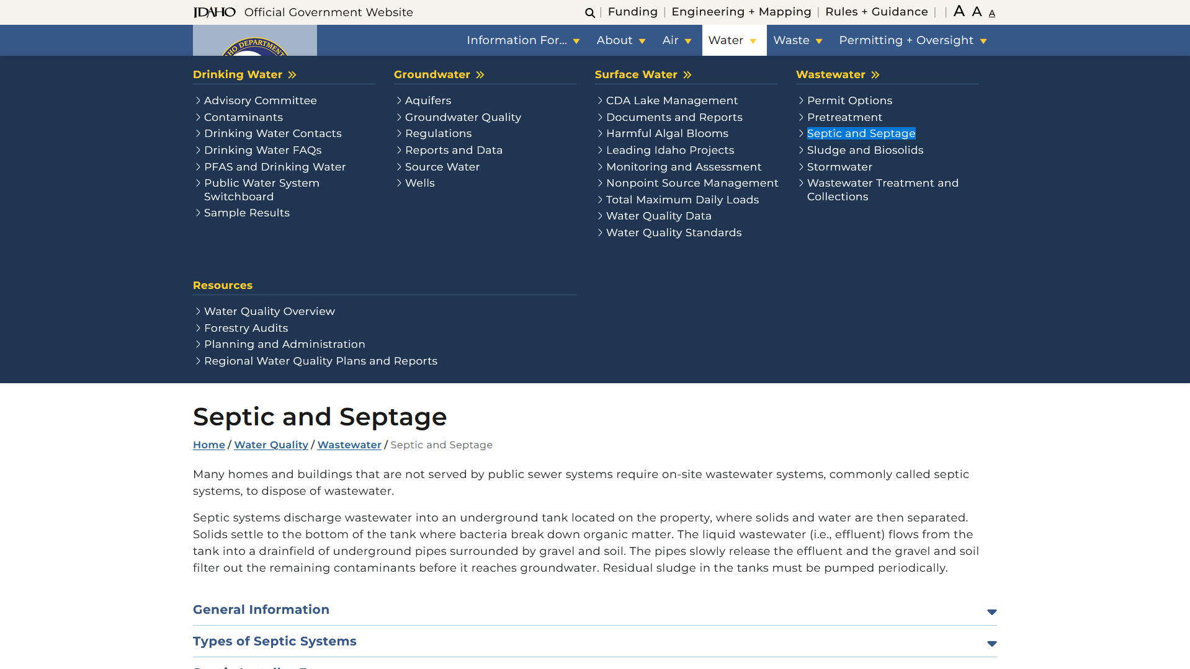
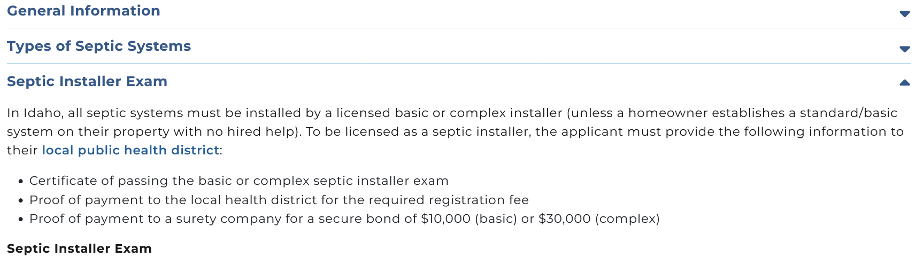
Visit: deq.idaho.gov
Notes:
Has anybody recently taken the online exam, any feedback to share?

Slide 7
IDAPA 58.01.03 Rule Updates - Individual/Subsurface Sewage Disposal Rules and Rules for Cleaning of Septic Tanks
Notes:
It’s important and this RULE gives us our purpose for being here today. This IDAPA rule forms the foundation of our regulatory decisions and guides your work in the field.

Slide 8
58.01.03 Rule Updates
🔎 Search “IDAPA Rules” adminrules.idaho.gov/current-rules/

Slide 9
58.01.03 Rule Updates
Zero-Based Rulemaking (ZBR) – structured review.
  Executive Order No. 2020-01, Zero-Based Regulation, issued by Governor Brad Little on January 16, 2020.
  A full, start-from-scratch review of the septic rules, not just small tweaks.
  Simplified and updated requirements, including clearer definitions and processes.
  Moved key technical guidance directly into the rule to make expectations clearer.
  Removed outdated or overly detailed requirements that were no longer needed.
Notes:
Comprehensive review of the entire septic rule chapter, not just incremental edits.
Revision and simplification of many provisions, including definitions and procedural requirements.
Reorganization of certain technical guidance into the rule text itself, clarifying expectations.
Removal or updating of outdated or overly prescriptive language
Idaho is the least regulated state in the US, ranking 48th

Slide 10
58.01.03 Rule Updates
Updated definitions to include terms like absorption bed, drain field, and minimum tank capacity.
Simplified permitting and approval processes for septic systems.
Increased minimum septic tank capacity from 750 to 1,000 gallons.
Raised bonding requirements: basic installers and service providers to $10K; $30K for complex installers.
Reduced some separation distances between drain fields and surface waters or utilities based on updated technical guidance and nutrient research.

Slide 11


58.01.03 Rule Updates
TGM updates and installer exams are sync'd with new Rule updates
Reduced 1000 words!

Slide 12
Technical Guidance Committee

Slide 13


Next TGC Meeting
Meets quarterly
Maintains the TGM & reviews septic products
Upcoming Meeting:
  March 5, 2026 9:30am MST (Teams and in-person)
  deq.idaho.gov townhall.idaho.gov

Slide 14
Technical Guidance Committee
Consists of 6 members:
  Senior Onsite Wastewater Analyst (chair) - DEQ
  3 environmental health specialists from Idaho health districts
  Professional engineer (PE) licensed in Idaho
  Permitted septic system installer
  All appointments are for 3-year terms (except DEQ)

Slide 15
2025 Updates to TGM

Slide 16
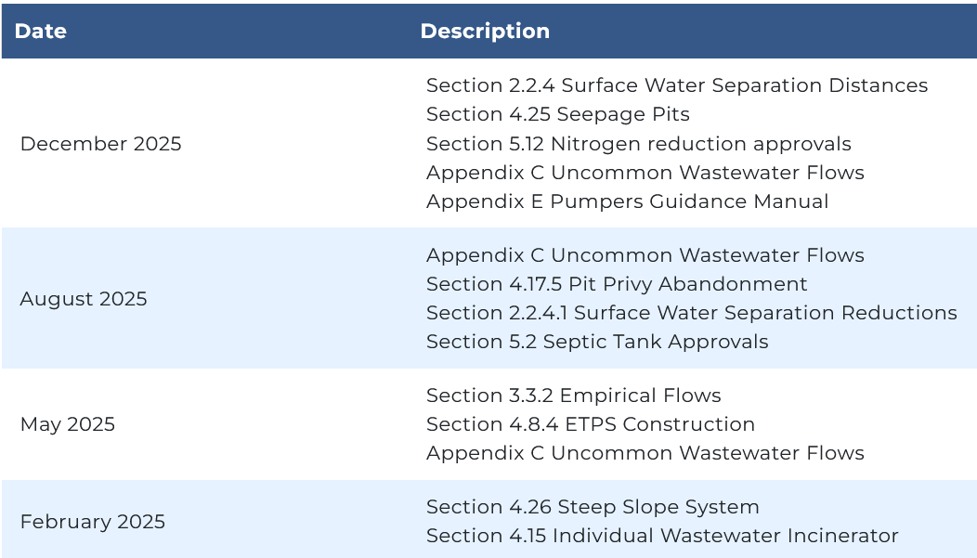

Slide 17
Section 4.15 Individual Wastewater Incinerator
Whole-home incinerators vs. Incinerator Toilets.
Whole-home systems hand all wastewater flow and require a licensed Idaho PE for design.
Whole-home systems require septic tanks, alarms, flow controls, and low-flow fixtures.
Whole-home incinerators are tank only permits
Incinerating toilets are self-contained units limited to human waste only.
Incinerating toilets require separate graywater disposal.
Notes:
Tank only permit
Low flow fixtures
Designed by a PE
90% capacity cannot receive anymore

Slide 18
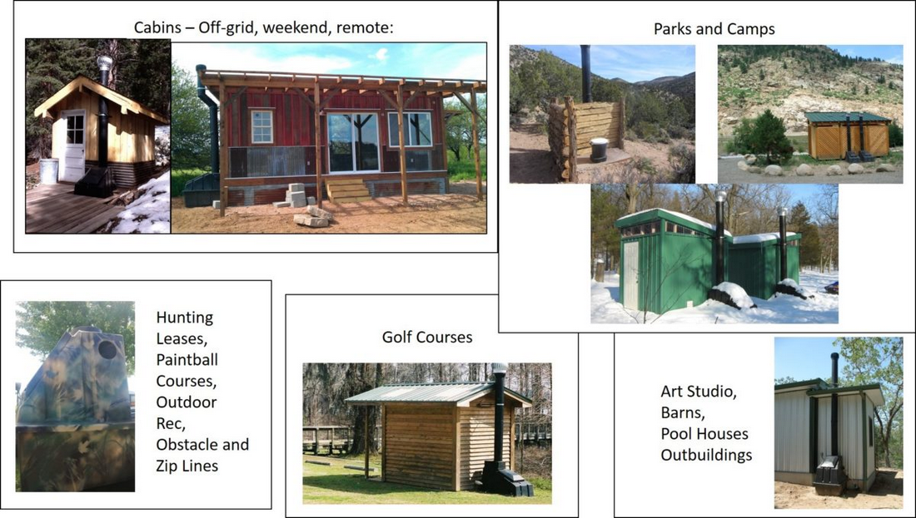
Notes:
SWsloo

Slide 19
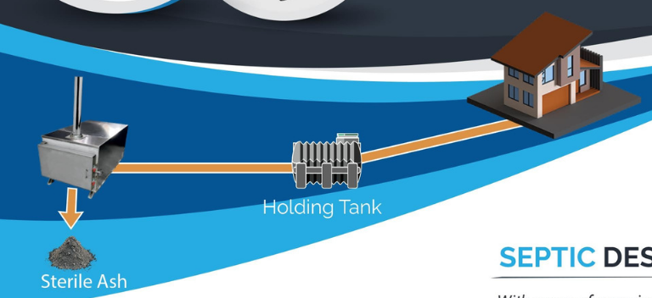
Notes:
ecojohn

Slide 20
Section 4.26 Steep Slope System
Added guidance for Steep Slope Systems, clarifying how systems should be designed on steep terrain.
Slopes greater than 20% but less than 46%.
A & B Soils only
Notes:
Only in A and B soils
Can be in C soils with a proprietary product, if designed for it
Separation distances must be met from the uphill side

Slide 21
Section 4.8.4 ETPS Construction
Section 4.8.4 ETPS Construction modernized (May 2025), clarifying current construction methods, pretreatment expectations, and what constitutes compliant installation.
There are two recently provisionally approved ETPSs:
Anua PuraSys and FujiClean they are nitrogen-reducing and are now included in the TGM Section 5.12
Notes:
Requires a licensed complex system installer
Licensed plumbers and electricians will be required to install specific devices and components for proper system operation
Within 30 days of completing the installation, the property owner must provide certification to the regulatory authority, from their manufacturer’s representative, that the system has been installed and is operating in accordance with the manufacturer’s recommendations (IDAPA 58.01.03.005.15).

Slide 22

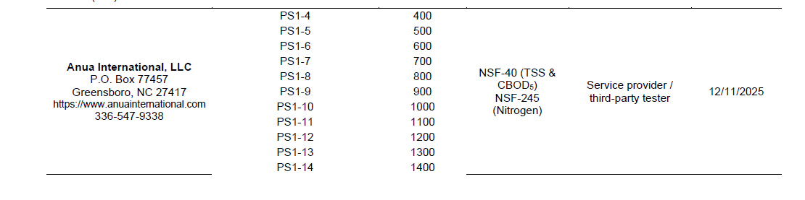
Notes:
Not to be confused with the Korean skincare products

Slide 23


Slide 24
Section 3.3.2 Empirical Flows
Section 3.3.2 Empirical Flows updated (May 2025), refining how expected wastewater flows should be determined for design sizing.
What Counts as Empirical Data
Minimum of 3 Comparable Facilities
Daily usage preferred, weekly or monthly
Notes:
minimum of three facilities of similar operation
Daily usage data are preferrable, but weekly or monthly data may also be considered.
devoid of irrigation flows be provided
Slide 1 – Section Update Overview
Section 3.3.2 Empirical Flows (Updated May 2025)
Refines how expected wastewater flows are determined for design sizing
Emphasizes real-world measured data over default rule values
Adds clearer expectations for data sources, timeframes, and documentation
Slide 2 – What Counts as Empirical Data
Collected from similar operating facilities
Typically based on water meter usage or direct wastewater measurements
Must be converted to gallons per day (GPD)
Meter units must be verified for accuracy
Key Change:
Greater clarity on acceptable measurement sources and unit verification
Slide 3 – Comparable Facility Requirements
Prefer Idaho facilities when available
Out-of-state facilities allowed if unique use type
Must support per-unit flow estimates:
Employees
Meals served
Visitors/occupancy
Other measurable units
New Emphasis:
Clear linkage between facility statistics and daily flow calculation
Slide 4 – Nondomestic Wastewater
Required when wastewater includes commercial or industrial sources
Must provide:
Flow data
Wastewater characterization
Supplemental DEQ application materials
Key Update:
Stronger requirement for characterization alongside flow estimates
Slide 5 – Seasonal & Irrigation Considerations
Data must represent peak facility usage period
Prefer non-irrigation water use
Typical non-irrigation window: November–February
Irrigation removal only allowed if not peak season
Clarification Added:
More precise guidance on seasonal data validity
Slide 6 – Using Data from the Existing Facility
Allowed instead of three comparison facilities
Requires minimum 2 years of water-use records
Health District must evaluate before approving added flow
New Requirement:
Defined two-year minimum dataset for expansions
Slide 7 – Minimum Documentation Expectations
Adequate data generally includes:
Three similar facilities’ water-use records
Written usage statistics (employees, meals, occupancy, etc.)
Appropriate timeframe supporting design flows
Nondomestic characterization when applicable
Any additional Director-requested data
Update Focus:
Clearer list of what is considered sufficient documentation
Slide 8 – Director Review & Limitations
Director determines acceptable daily wastewater flow
Inadequate data excluded from evaluation
Using empirical data does NOT guarantee lower flows than IDAPA defaults
Key Takeaway:
Empirical method provides flexibility, not automatic reduced design flow

Slide 25
Section 3.3.2 Empirical Flows
Nondomestic Wastewater – needs to be residential strength
Seasonal & Irrigation Considerations (don’t count landscape watering)
Statistics on facility's operation (staffing, peak customer season, number of units served, tempo of activity)
Other facility specific data the Director feels is reasonable

Slide 26
Section 5.2 Septic Tank Approvals
This section ensures that only DEQ‑approved septic tanks are used in Idaho systems and clarifies how tanks are approved and listed.
*Remember – minimum tank size is _,___ gallons
Notes:
Cleaned up the inventory of approved septic tanks.

Slide 27
Section 4.17.5 Pit Privy Abandonment
New Section 4.17.5 Pit Privy Abandonment
Dismantle the privy building and dispose of any sewage-contact materials at a landfill.
Fill the pit with rock-free soil and mound it to allow for about 12 inches of settling.
Mark the site and protect it from traffic and excavation.
If a subsurface system is installed at a single-family home, any existing pit privy must be abandoned unless the Director approves otherwise.
Notes:
1. The privy building should be dismantled, and the portions of the building that may have come into contact with human sewage should be disposed of in a landfill.
2. The pit must be filled with soil that is free of rock and graded to allow for about 12 inches of settling.
3. The site should be marked and protected from traffic or excavation activities.
4. If a subsurface system is installed on a property with a single-family home, any pit privy on the property must be abandoned, unless otherwise approved by the Director.

Slide 28
Section 5.12 Nitrogen reduction approvals
Section added/updated (Dec 2025),
  Outline criteria and documentation needed for nitrogen‑reducing systems to be approved.
The TGC voted to tabled this section upon further research: to add drip distribution as a nitrogen-reducing system, down to 27 mg/L.

Slide 29
Section 4.25 Seepage Pits
New dedicated Section 4.25 Seepage Pits added in late 2025,
Seepage pit disposal facilities may be used only for replacement systems on a case-by-case basis as a last resort.
Seepage pit systems must meet all horizontal setbacks.
The pit bottom must be no deeper than 18 feet below the natural ground surface.
Not be installed in design group C soils.
Notes:
used only for replacement systems on a case-by-case basis as a last resort if no other subsurface discharging alternatives

Slide 30
Section 2.2-2.2.4 Surface Water Separation Distances
Refined criteria for setbacks near waters based on recent technical review.
Broader flexibility with conditions, updating language to reflect current research and case‑by‑case evaluation.

Slide 31
Removes a previously undocumented 300-foot setback

Slide 32
Appendix C. Uncommon Wastewater Flows
Appendix C Uncommon Wastewater Flows expanded and updated in May and December 2025 to clarify flow rates and design considerations for atypical water uses (e.g., multi‑use dwellings, non‑residential).
Expands on the table in Rule on “Wastewater Flows from Various Establishments”

Slide 33
Residential
Accessory Dwelling Unit (ADU)
Dwelling with Daycare
Residential Workshop/Barn/Shed with a Toilet and Sink
Residential Workshop/Barn/Shed with a Full or
3/4 Bathroom
Single family home with extra kitchen or extra laundry room.
RV Wastewater Hookup at Private Dwelling
Tiny Home

Slide 34
Non-Residential
(Letter of Intended Use Required)
Animal Processing Facility
Animal Shelter/Kennel
Bakery
Barber Shop
Brewery
Butcher Shop
Car Wash
Coffee Shop / Café
Doctor's Office/Dentist
Dog Washing
Grey Water Sump for a Campground with a Drinking Water Source but No Bathrooms
Grey water Sump for a Dry Campground
Gym / Health Club / Spa
Laundry at a Campground / RV Park
Marina Bathroom
Public Park Bathroom
Salon
Ski Resort
Veterinarian

Slide 35
Appendix E^{NEW} – Pumpers Guidance Manual (Dec 2025)
Septic System Components
Checking Levels of Scum and Sludge
Septage Pumping (maintenance, safety, pumping, hauling, and disposal).
Pumper Permit Requirements

Slide 36
DEQ memorandums

Slide 37
Appendix D - DEQ Memorandums
Notes:
All active memorandums maintained by the Idaho Department of Environmental Quality related to on-site wastewater disposal systems.

Slide 38
Use of Wastewater Holding Tanks
Purpose: Updates 1981 guidance on holding tanks as Alternative Systems.
Alternative System: Any non-standard system approved by DEQ following TGC recommendations.
Holding Tanks: Short-term, limited reliability; maintenance depends on owner initiative.
Approval Conditions:
  Needed to protect public health/environment while pursuing long-term solution.
  Sewer services confirmed within six months, and portable units impractical.
Not Allowed: Delaying standard septic system construction is insufficient.
TGM details design and approval conditions that incorporate a wastewater holding tank:
  Floating vault toilets / boat/vessel sewage disposal
  Portable sanitation units
  RV dump stations
  Vault privies
DEQ Review: Only approved when site-specific use poses minimal risk to health and environment.
Notes:
It’s an alternative system
Not allowed as the final solution

Slide 39
Septic Tank Manholes
DEQ Memo, July 1, 2025
Purpose: Clarifies that septic tank manholes must extend to finish grade (IDAPA 58.01.03.007.14).
Scope: Applies to all tanks, compartments, and multiple tanks in series.
Manhole Requirements:
  Minimum 20-inch dimension or equivalent removable cover.
  Must provide access to each tank or compartment containing a pump, effluent filter, or treatment component.
  Concrete or composite/FRP covers must have corrosion-resistant strap or handle for removal.
Risers:
  If a riser extends a manhole to finished grade, no additional tank lid cover is needed.
  Riser must have a secured cover at finished grade (locked or screwed).
  Riser must be secured to the tank lid.
General Guidance: Memo is advisory, does not override law, and DEQ may update policies anytime.

Slide 40
RV Park Memo – May 24, 2023
Applies to RV parks / travel trailer parks and campgrounds with RV hookups
Addresses how RV wastewater must be collected, managed, and disposed
If you are contacted by someone wanting to design/install a subsurface system or dump station at an RV park, read this memo and TGM section 4.20

Slide 41
10% Setback Reduction for Replacement Systems
Only for replacement systems, not new installations.
Allowance: Up to 10% reduction in drainfield-to-well setback (e.g., 100 ft to 90 ft).
Allowed under IDAPA 58.01.03.010.01 Variances - technical allowance.
Should be used only when a replacement system cannot meet standard setbacks.
Benefit: Provides flexibility for challenging lots.

Slide 42
Aligning Installation Requirements With NSF Standard 40
Updated installation manuals,
Reducing required sand bedding from 12 inches to 6 inches, (consistent with NSF Standard 40 testing requirements)
Reducing use of costly C-33 sand (~$50/yard)

Slide 43
Tank Approvals and Modifications

Slide 44
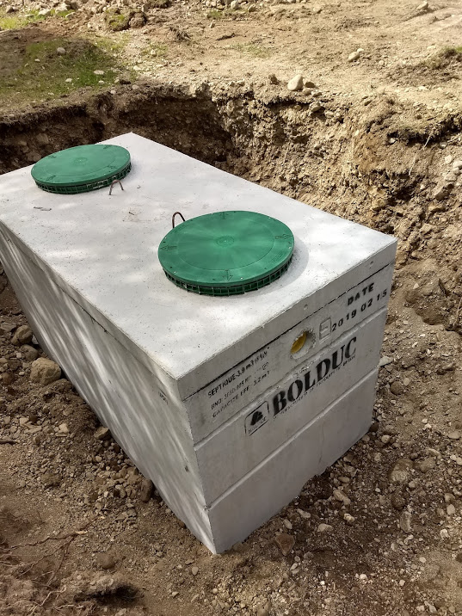
Tank Approvals & Modifications
Always ensure a tank is approved in TGM Section 5.2 before purchasing a tank
Do not modify a tank in the field

Slide 45
Tank Approvals & Modifications
If you are unsure if a tank is approved or not, double check with DEQ or the Health District.
Just because a store in Idaho is selling a tank doesn’t mean it’s approved.
Notes:
We don’t regulate what people can sell, only what can be installed.

Slide 46
Tank Approvals & Modifications
Some examples of field modifications that we don’t allow:
  Drilling new inlet/outlet holes
  Using a different lid
  Turning a single-compartment tank into a two-compartment tank
  Sealing a crack to get it to pass a leak test

Slide 47
Tank Approvals & Modifications
If a modified or custom tank is needed for a project, the manufacturer must get written approval from DEQ before it can be installed.
  This requires new design drawings, structural calculations, P.E. sign-off, and time.
  Installers should not put a custom or modified tank in the ground and then seek approval. They will most likely have to pull it out.

Slide 48
By the Numbers: Idaho Septic Permits in 2025

Slide 49
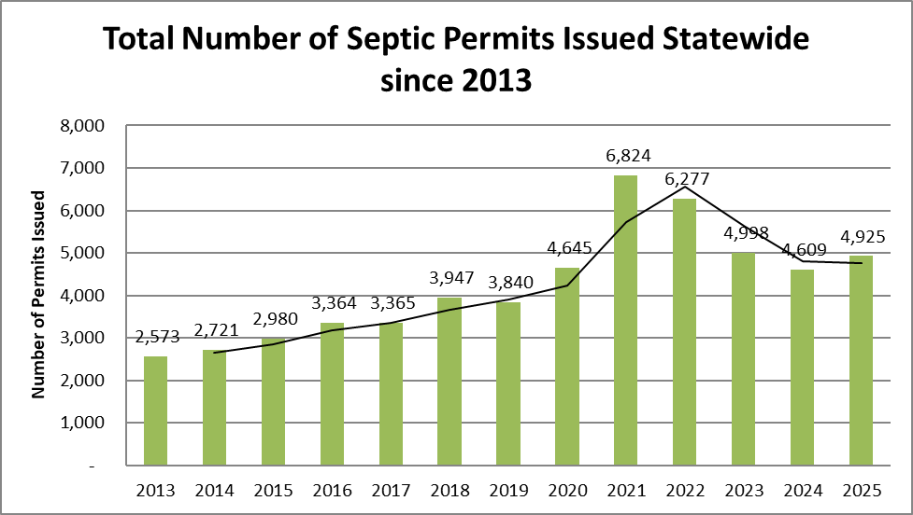
4,925 permits issued, ⬆️7%

Slide 50
128 pumper permits issue, ⬇️5%

Slide 51
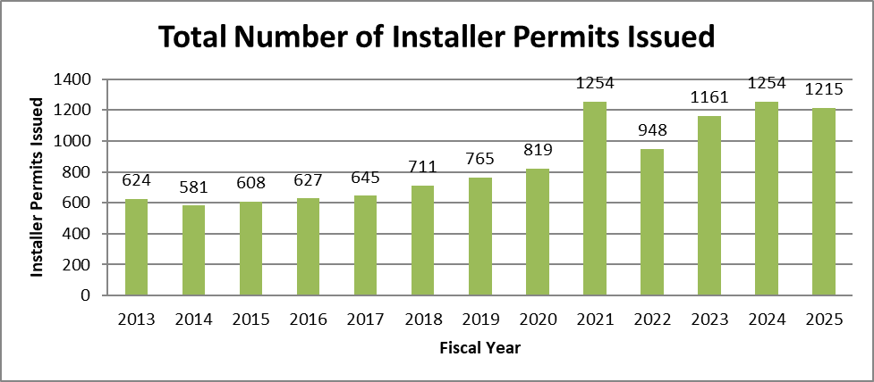
1215 installer permits issued, ⬇️3%

Slide 52
Questions?
James Craft
Wastewater Compliance Bureau Chief

